Slide 1
Jit Team & 3LO 2019-2020
{ CSS }

Slide 2
CSS cascading style sheets
Language describing how HTML elements should look like.

Slide 3
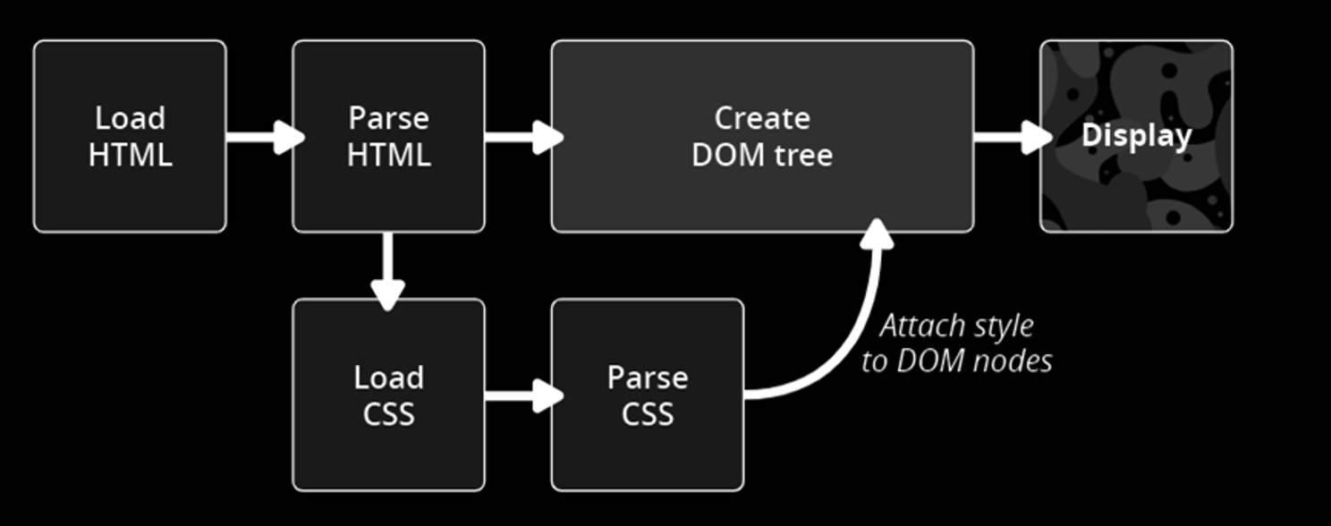
CSS behind the scenes

Slide 4
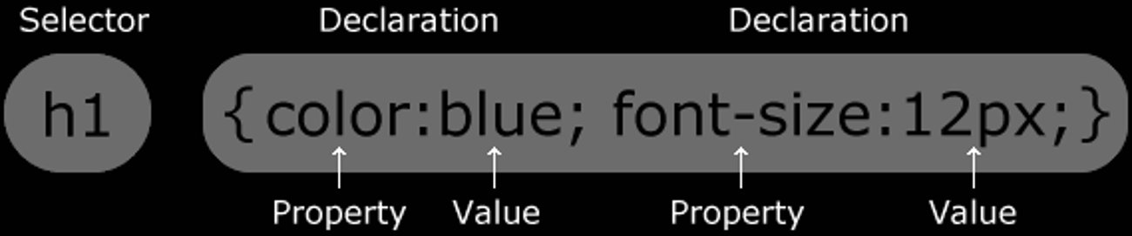
CSS syntax

Slide 5
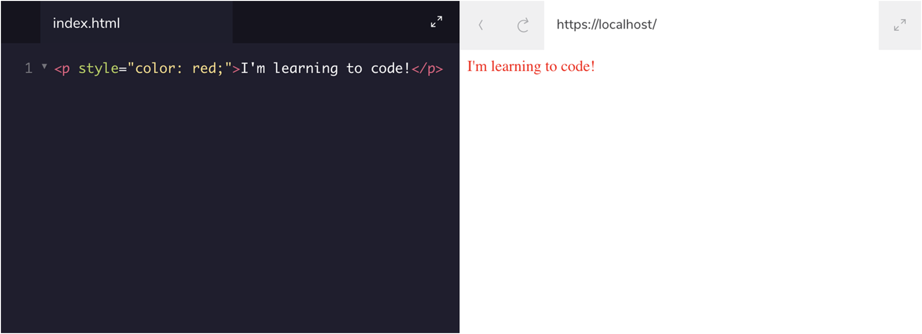
CSS inline styles

Slide 6
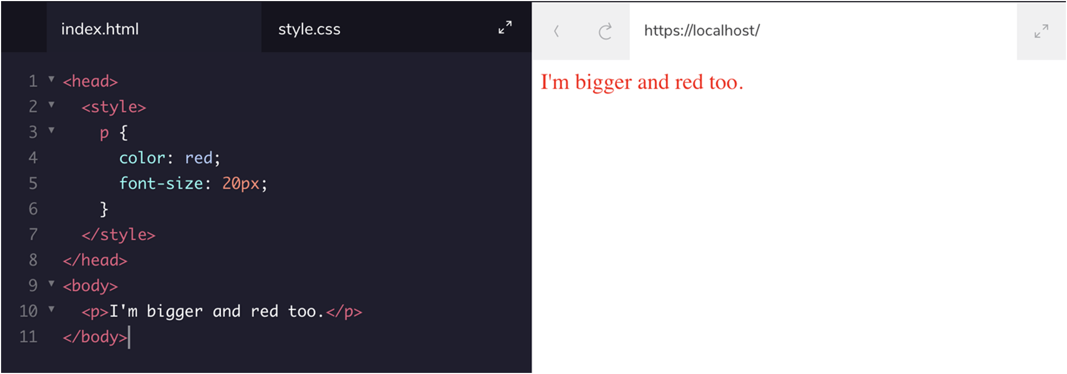
CSS <style> tag

Slide 7
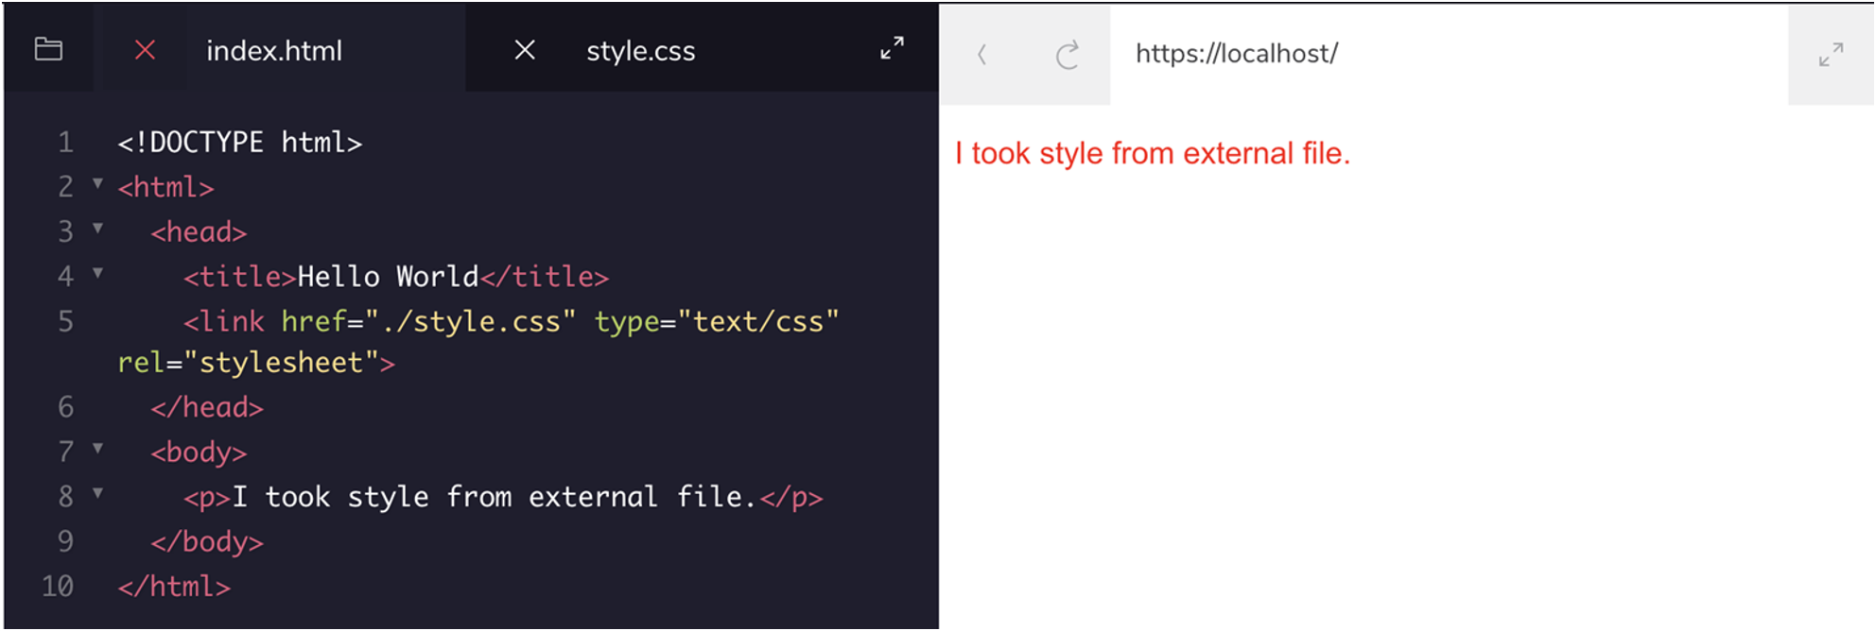
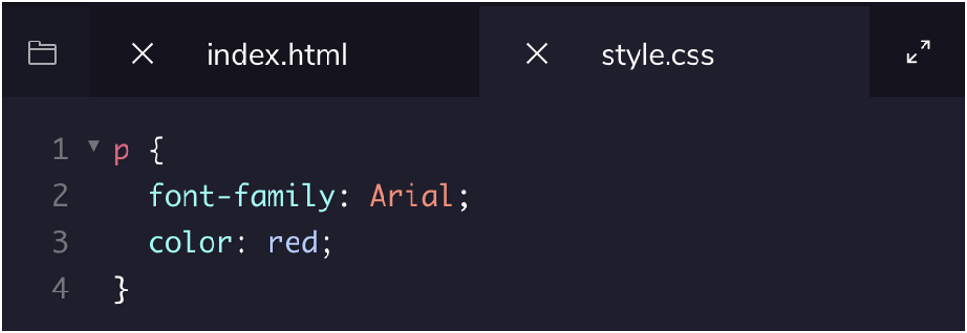
CSS external styles

Slide 8
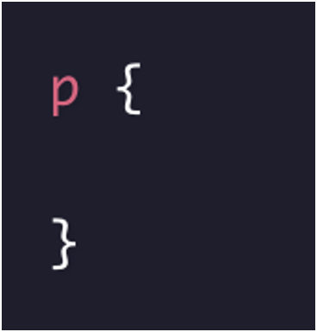
CSS selectors: tag name

Slide 9
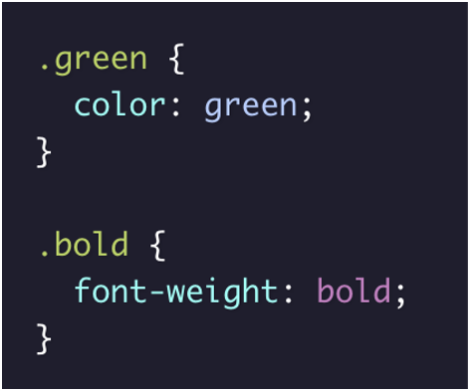

CSS selectors: class name

Slide 10
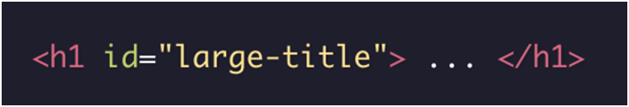

CSS selectors: ID name

Slide 11
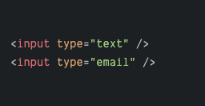
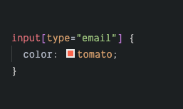
CSS selectors: attribute name

Slide 12
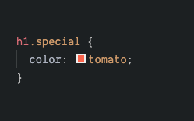
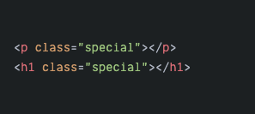
CSS chaining selectors

Slide 13
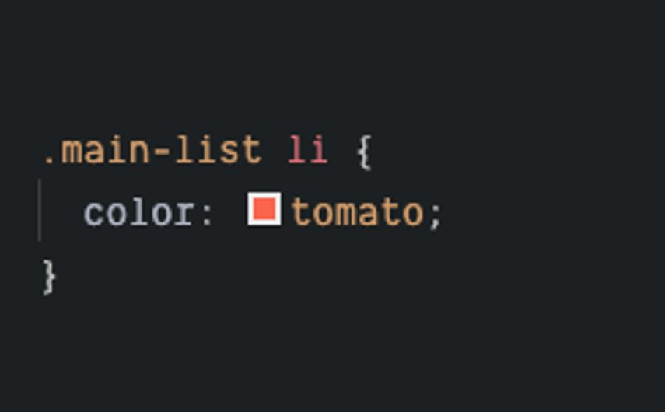
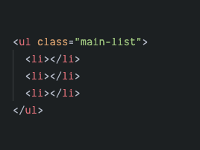
CSS nested selectors

Slide 14
CSS pseudo-classes
:link – selects all unvisited links
:hover – selects elements on mouse hover
:visited – selects all visited links
:active – selects an element while it is being selected by the user, for example, when the user is mid-click
:focus – selects an element that is being focused via click or keyboard even, for example, tabbing through a website

Slide 15
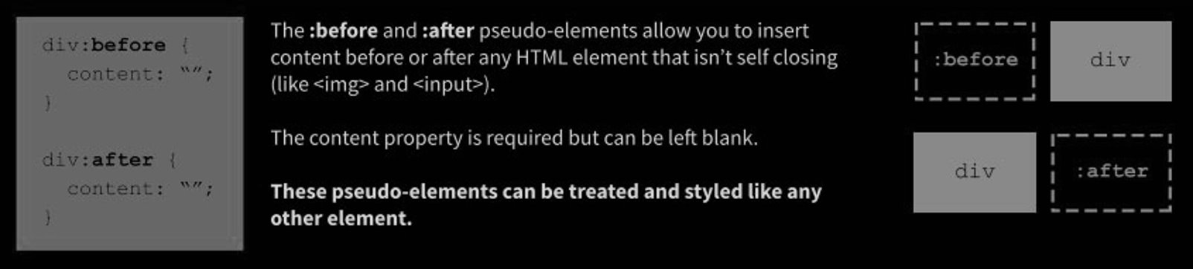
CSS pseudo-elements

Slide 16
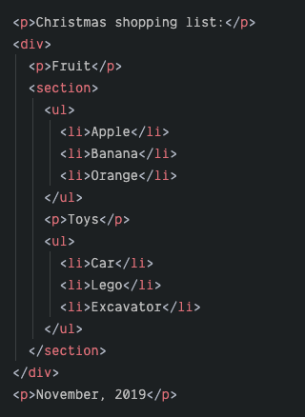
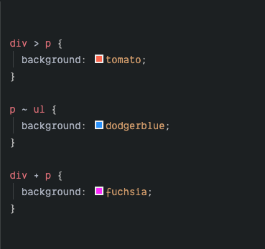
CSS combinators
div > p – parent selector – selects all paragraphs where the parent is a div element
div + p – sibling selector – selects all paragraphs that are placed immediately after a div element
div ~ p – sibling selector – selects all paragraphs that are preceeded by a div element

Slide 17
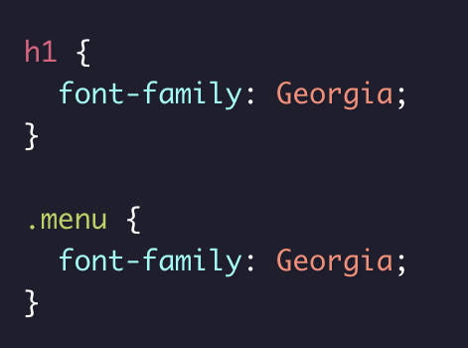
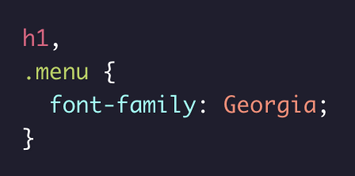
CSS multiple selectors
=

Slide 18
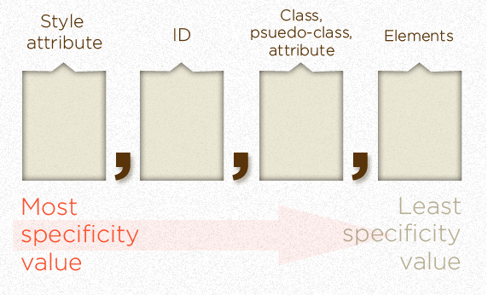
CSS specificity
Specificity is the order by which the browser decides which CSS styles will be displayed.

Slide 19
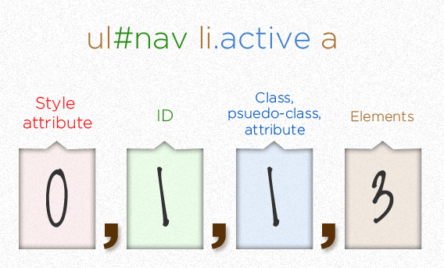
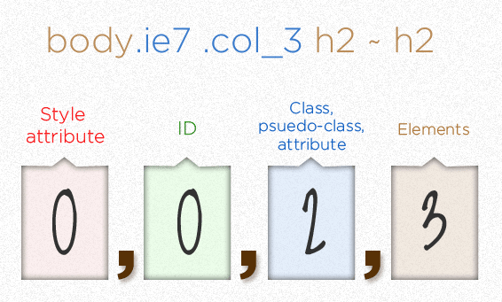
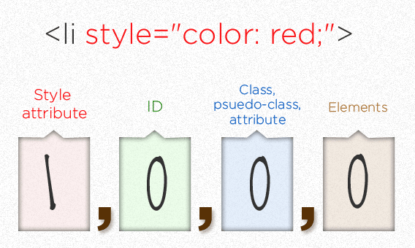
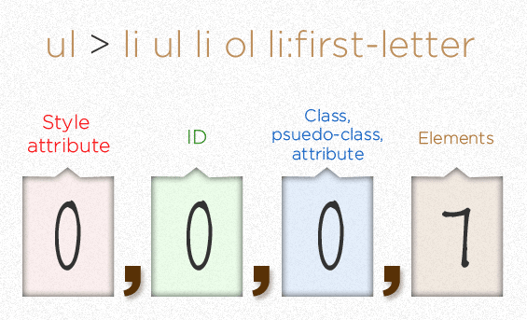
CSS specificity

Slide 20
CSS basic properties
color: white, #FFFFFF, rgba(255,255,255,1);
background-color: black, #000, rgb(0,0,0);
font-family: "Times New Roman";
font-size: 18px, 2em, 3rem;
opacity: 0.5;
background-image: url("./image.png");
font-weight: 400, normal;
text-align: right, center, left;
Notes:
Jest więcej jednostek dla font-size ale te sa najpopularniejsze.
Jednostka "em" jest relatywna do font-size rodzica, a rem do elementu :root.

Slide 21
CSS box model
margin
border
padding
content

Slide 22
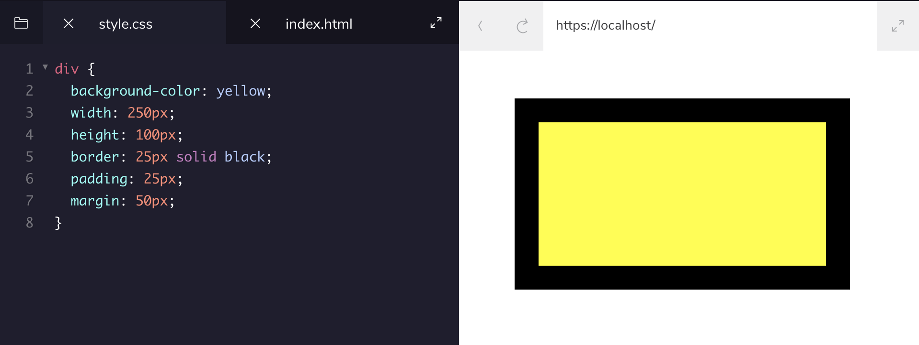
CSS box model

Slide 23
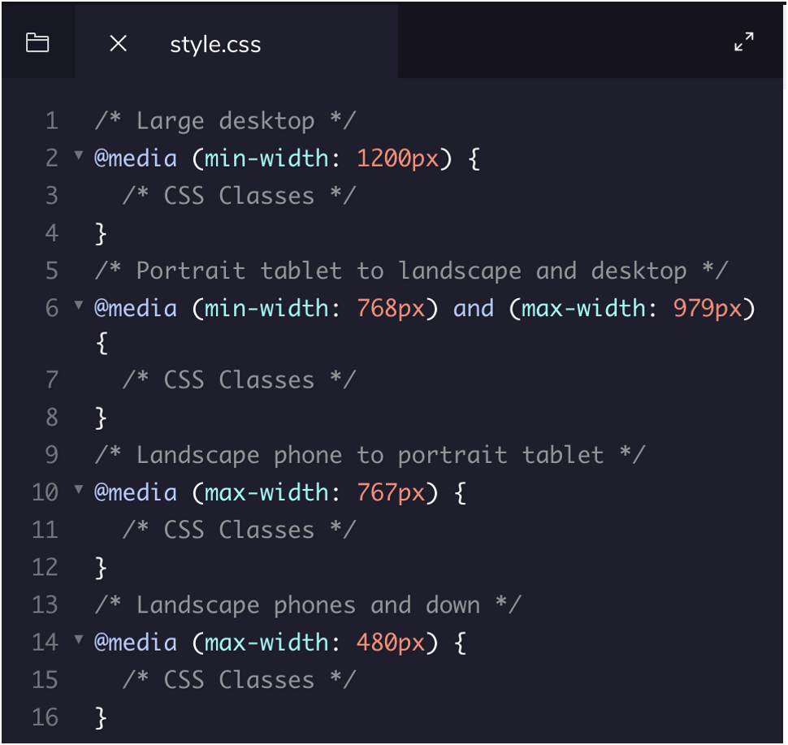

CSS media queries

Slide 24
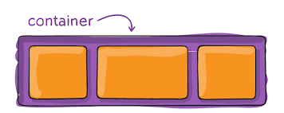
CSS flexbox layout module
Makes creating responsive layouts easier

Slide 25
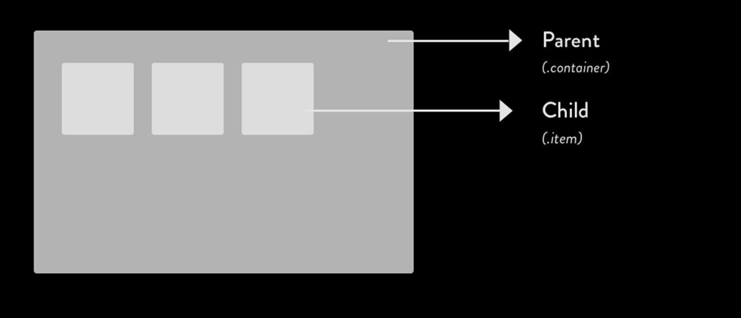
CSS flexbox anatomy

Slide 26
CSS flexbox properties
Flex container properties
flex-direction
flex-wrap
flex-flow
justify-content
align-items
align-content
Flex item properties
order
flex-grow
flex-shrink
flex-basis
flex
align-self

Slide 27
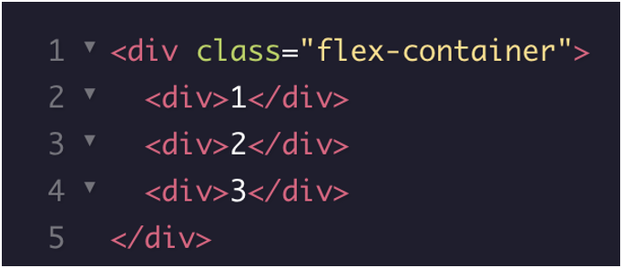
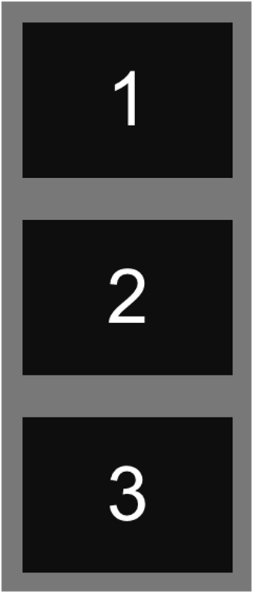
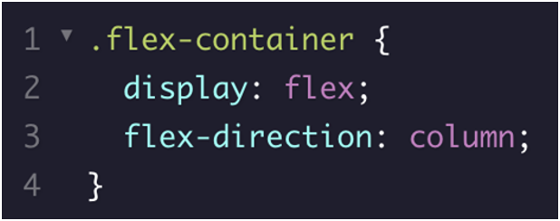
CSS flexbox properties

Slide 28
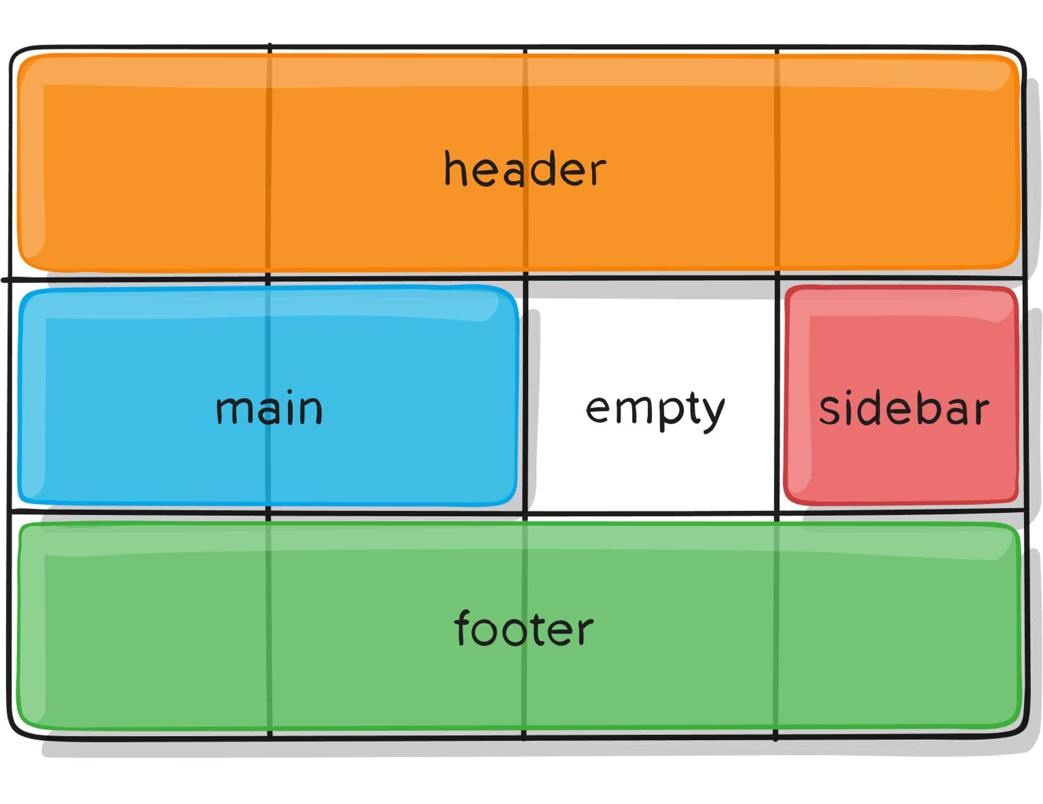
Grid Layout Module
Makes creating layouts easier
Notes:
Róznica pomiędzy flexbox a gridem: flexbox jest jednowymiarowy – column albo row – a grid jest dwuwymiarowy – osie x, y.

Slide 29
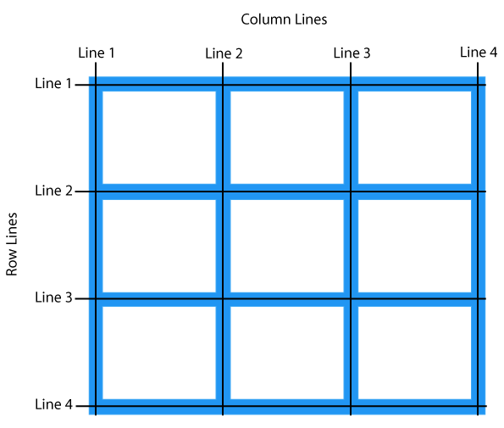
Grid anatomy

Slide 30
Grid properties
Grid container properties:
Grid-template-columns
Grid-template-rows
Grid-template-areas
Grid-gap
Justify-items (horizontally)
Justify-content
Align-items (vertically)
Align-content
Grid-auto-columns
Grid-auto-rows
Grid-auto-flow
Grid item properties:
Grid-column
Grid-row
Grid-area
Justify-self
Align-self

Slide 31
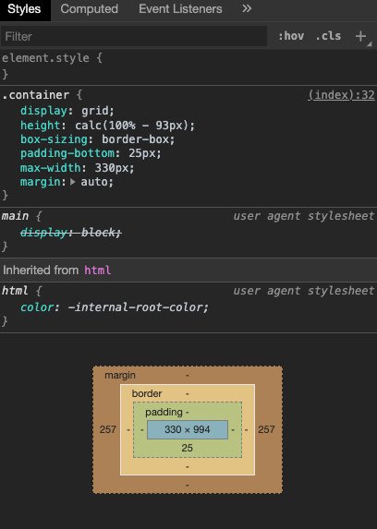
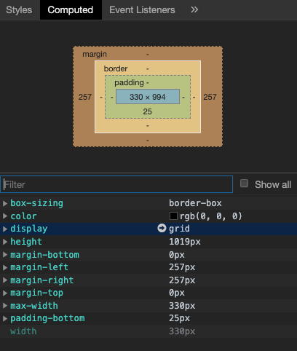
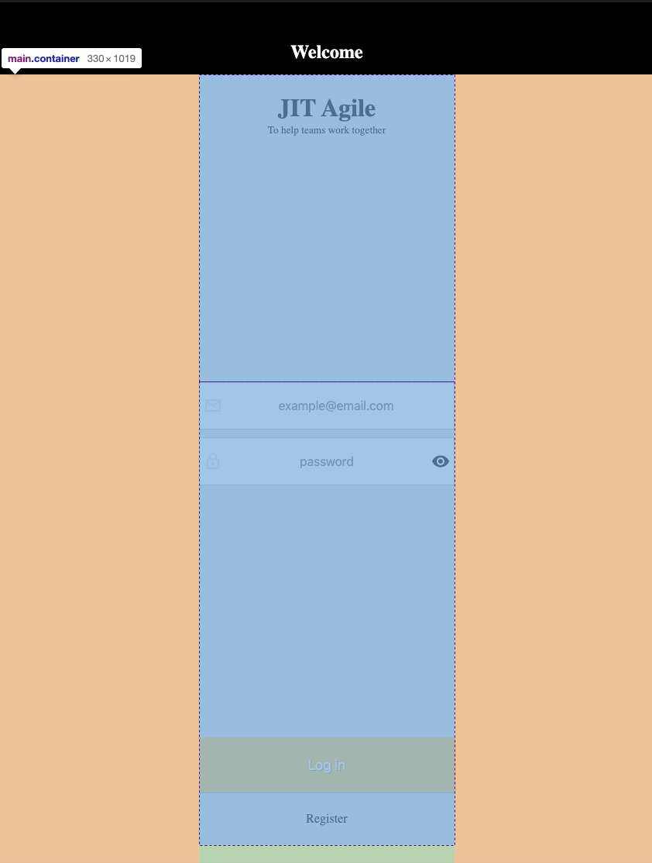
CSS debugging

Slide 32

CSS where to go from here?
css-tricks.com
flexboxfroggy.com
flexbox.io
cssgridgarden.com
cssgrid.io
Notes:
Firefox developer edition ma najlepsze devtoolsy do flexboxa I grida

Slide 33
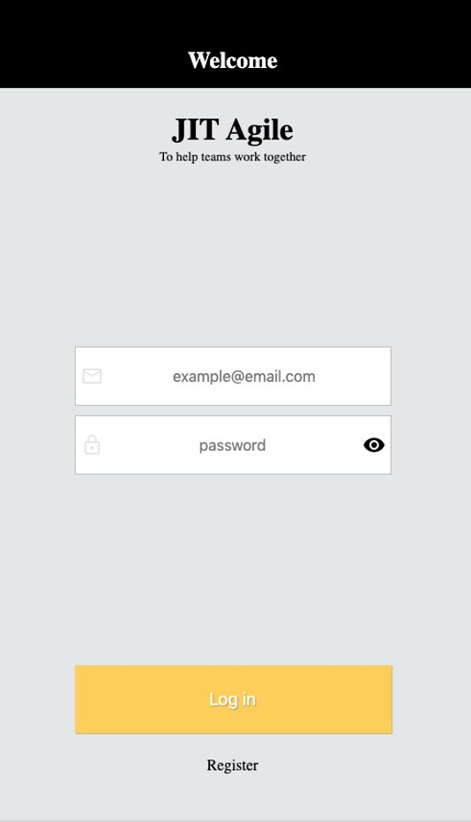
Exercise #1 login page
Notes:
To co nie zdazymy moga zrobic w domu - a strona register jest do domu do ćwiczenia bo to jest to samo co tutaj tylko inaczej ;)
Przykladowa implementacja dla login page: https://codesandbox.io/s/twilight-sun-veowr

Slide 34
Exercise #1 primary header
It should:
span the entire width of the viewport
have increased vertical padding ~ 3:1 ratio
have centered, white text on black background – use hexcode or rgb colors
CSS properties you'll need for this task: background, padding, margin, color, text-align

Slide 35

Exercise #1 background
It should:
span the entire width and height of the viewport
Background colour set to #e5e6e8
CSS properties you'll need for this task: background, height

Slide 36

Exercise #1 secondary header
It should:
be aligned horizontally on the page
Have a 25 px space from primary header
CSS properties you'll need for this task: margin, text-align

Slide 37
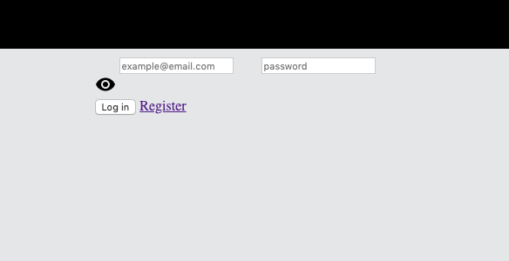
Exercise #1 form
It should:
be centered on the page
Span 100% of the viewport width up to 330 pixels
CSS properties you'll need for this task: margin, width, max-width

Slide 38
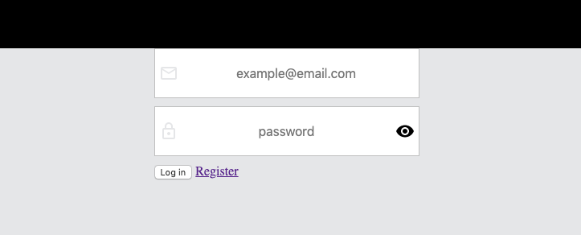
Exercise #1 form inputs
Each input and icon(s) should be inside a flex container
Flex containers should all be on a separate line
Flex container should have a solid border, 1 pixel thick - #B0B1B5 - and white background
Input should take up all free space and have no border
Text inside inputs should be centered and 16 pixels in size
Space between input and icon(s) should be 5 pixels
CSS properties you'll need for this task: display, border, margin, padding, background, flex, text-align, font-size

Slide 39
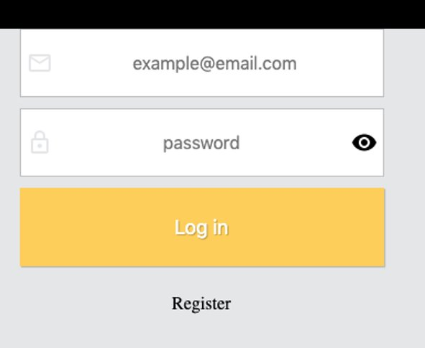
Exercise #1 buttons
Put both buttons inside a flex container
Each button should be on a separate line
Register button should be plain black text, middle-aligned with no underline
Both buttons should have top and bottom padding of 25 pixels
Login button should have white text – 18 pixels in size - on yellow background - #ffcf51 – and no border
Button and text have shadow with x:1 y:1 blur:1 values and rgba(0,0,0,0.24) color
CSS properties you'll need for this task: display, flex-direction, text-decoration, text-align, color, padding, background, border, box-shadow, text-shadow, font-size

Slide 40
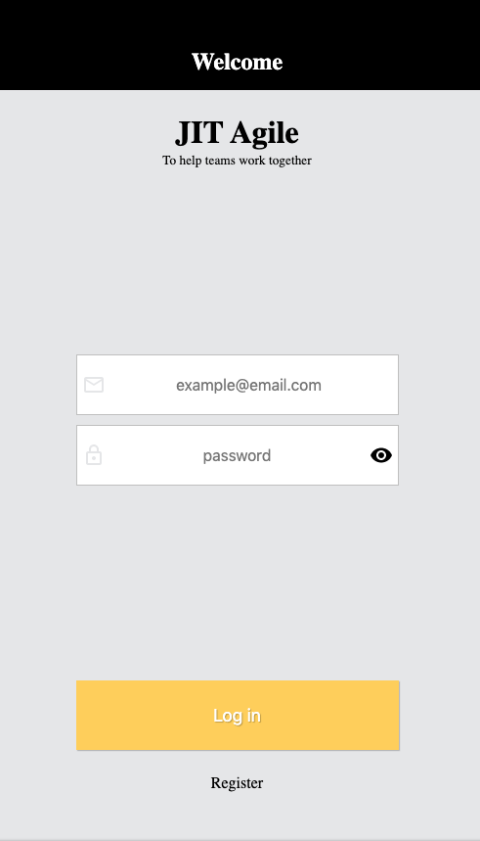
Exercise #1 layout
Turn .container into a grid container
Calculate its height based on the height of its parent minus the height of the primary header
Form should have height 100%
Form should be a grid container
Grid items should have space around
CSS properties you'll need for this task:
display, height + CSS calc, justify-items

Slide 41
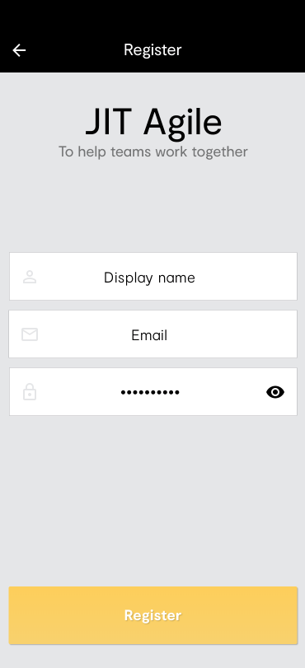
Exercise #2 register page

